Slide 1

Java Definitions
Object - Objects have states and behaviours. Example: A dog has states - colour, name, breed as well as behaviours -wagging, barking, eating. An object is an instance of a class.
Class - A class can be defined as a template/ blue print that describes the behaviours/states that object of its type support.
Methods - A method is basically a behaviour. A class can contain many methods. It is in methods where the logics are written, data is manipulated and all the actions are executed.
Instance Variables - Each object has its unique set of instance variables. An object's state is created by the values assigned to these instance variables.

Slide 2
Data Types
Primitive Data Types
Reference/Object Data Types
byte b = 68;
char c = 'A';
int i = 5;
float f = 4.5f;
double d = 7.889;
long l = 5000l;
boolean b = true;
Integer int = new Integer(5);
Double dou = new Double (6.7);
Boolean bool = new Boolean.TRUE;

Slide 3
Primitive
Primitive data types are a direct value in memory
int a = 5;
int b = 5;
a == b ? ==
So it's true, a does equal b
5
5
5
5

Slide 4
Object
An object is a reference to some data
Integer x = new Integer(5);
Integer y = new Integer(5);
if(x == y) → FALSE ==
if(x.intValue() == y.intValue()) → TRUE
4x67f
5
6577d
5
4x67f
6577d

Slide 5
Class
An Object that be instantiated (generally)
public class Dog{
String breed;
int ageC
String color;
void barking(){
}
void hungry(){
}
void sleeping(){
}
}

Slide 6
Classes Have
Local variables: Variables defined inside methods, constructors or blocks are called local variables. The variable will be declared and initialized within the method and the variable will be destroyed when the method has completed.
Instance variables: Instance variables are variables within a class but outside any method. These variables are initialized when the class is instantiated. Instance variables can be accessed from inside any method, constructor or blocks of that particular class.
Class variables: Class variables are variables declared with in a class, outside any method, with the static keyword.

Slide 7
Classes also have COMMENTS!
// This is a one line comment
/*
* This is a block comment
*/
The comment says what you WANT/THINK the code to do/does
DO NOT DO THIS:
// add 1 to i
i = i + 1;
I know it adds 1 to i, but I have no idea why, or if it is correct thing to do

Slide 8
Classes also have COMMENTS!
DO THIS:
// I want to make the robot turn left so I'm increasing the angle
i = i + 1;
Now I know why you're doing it
I can also spots that should we be increasing the angle to go right?

Slide 9
Variables Scope
public class Dog{
static String NOISE = “Class variable”;
String breed = “instance variable”;
void barking(){
String var = ”local var”;
}
}

Slide 10
Variables Scope
public class Dog{
static String NOISE = “Class variable”;
String breed = “instance variable”;
void barking(){
String breed = ”local var”;
System.out.println(breed);
System.out.println(this.breed);
}
}
Telling Java to use the instance, rather
Than the local variable

Slide 11
Access Modifiers
public – everyone can access it
private – only this class can access it
protected – this class and classes that extend it can access it
<nothing> - default, other classes within the same package can access it
Set variables to the lowest visibility that you require, ideally everything is private

Slide 12
Non-Access Modifiers
final – The variable cannot be changed at run-time
static – The variable only exists once, all Objects will refer to the same variable (be careful with this)
abstract – The method must be implemented by a subclass, it does not yet exist
synchronized – The method can only be run once at a time. Some threads may have to wait

Slide 13
Constructors
Objects can be constructed multiple ways depending on the data available
new Puppy();
new Puppy(“Sammy”);
public class Puppy{
public Puppy(){
}
public Puppy(String name){
// This constructor has one parameter, name.
}
}

Slide 14
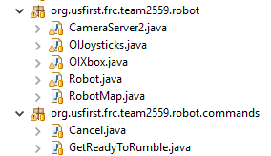
Imports
To use a class from another class you need to tell Java where to find it
Robot.java:
import org.usfirst.frc.team2559.robot.commands.Cancel;

Slide 15
Arithmetic Operators
Operator and Example
1 + ( Addition )
Adds values on either side of the operator
Example: A + B will give 30
2 - ( Subtraction )
Subtracts right hand operand from left hand operand
Example: A - B will give -10
3 * ( Multiplication )
Multiplies values on either side of the operator
Example: A * B will give 200
4 / (Division)
Divides left hand operand by right hand operand
Example: B / A will give 2
A = 10
B = 20

Slide 16
Arithmetic Operators
5 % (Modulus)
Divides left hand operand by right hand operand and returns remainder
Example: B % A will give 0
6 ++ (Increment)
Increases the value of operand by 1
Example: B++ gives 21
7 -- ( Decrement )
Decreases the value of operand by 1
Example: B-- gives 19
A = 10
B = 20

Slide 17
Relational Operators
SR.NO Operator and Description
1 == (equal to)
Checks if the values of two operands are equal or not, if yes then condition becomes true.
Example: (A == B) is not true.
2 != (not equal to)
Checks if the values of two operands are equal or not, if values are not equal then condition
becomes true.
Example: (A != B) is true.
3 > (greater than)
Checks if the value of left operand is greater than the value of right operand, if yes then
condition becomes true.
Example: (A > B) is not true.
4 < (less than)
Checks if the value of left operand is less than the value of right operand, if yes then
condition becomes true.
Example: (A < B) is true.
A = 10
B = 20

Slide 18
Relational Operators
5 >= (greater than or equal to)
Checks if the value of left operand is greater than or equal to the value of right operand, if
yes then condition becomes true.
Example (A >= B) is not true.
6 <= (less than or equal to)
Checks if the value of left operand is less than or equal to the value of right operand, if
yes then condition becomes true.
example(A <= B) is true.
A = 10
B = 20

Slide 19
Logical Operators
Operator Description
1 && (logical and)
Called Logical AND operator. If both the operands are non-zero, then the condition
becomes true.
Example (A && B) is false.
2 || (logical or)
Called Logical OR Operator. If any of the two operands are non-zero, then the condition
becomes true.
Example (A || B) is true.
3 ! (logical not)
Called Logical NOT Operator. Use to reverses the logical state of its operand. If a condition
is true then Logical NOT operator will make false.
Example !(A && B) is true.
A = true
B = false

Slide 20
Assignment Operators
Operator and Description
1 =
Simple assignment operator, Assigns values from right side operands to left side operand.
Example: C = A + B will assign value of A + B into C
2 +=
Add AND assignment operator, It adds right operand to the left operand and assign the result
to left operand.
Example: C += A is equivalent to C = C + A
3 -=
Subtract AND assignment operator, It subtracts right operand from the left operand and
assign the result to left operand.
Example:C -= A is equivalent to C = C - A
4 *=
Multiply AND assignment operator, It multiplies right operand with the left operand and
assign the result to left operand.
Example: C *= A is equivalent to C = C * A
MAKE YOU CODE CLEAR!

Slide 21
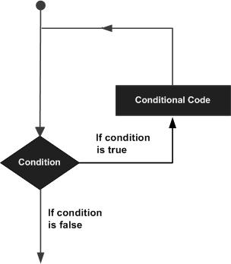
Looping
Keep doing something until a condition is met

Slide 22
Loop Types
while loop
Repeats a statement or group of statements while a given condition is true. It tests the
condition before executing the loop body.
for loop
Execute a sequence of statements multiple times and abbreviates the code that manages
the loop variable.
do...while loop
Like a while statement, except that it tests the condition at the end of the loop body
Try to avoid do..while
You have to scroll down the code to see what the loop is

Slide 23
Loop Control Statements
break statement
Terminates the loop or switch statement and transfers execution to the
statement immediately following the loop or switch.
continue statement
Causes the loop to skip the remainder of its body and immediately retest
its condition prior to reiterating.
Ideally don't use above
boolean shouldExit = false
while (!shouldExit) {

Slide 24
Enhanced Loop
The lazy way to loop through everything
Quick to code, but less control
int [] numbers = {10, 20, 30, 40, 50};
for(int x : numbers ){
System.out.print( x );
System.out.print(",");
}

Slide 25
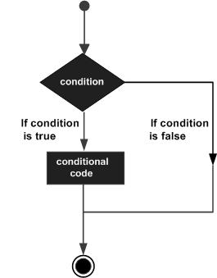
Decision Making
If (some condition) then...

Slide 26
Decision Making
if statement
An if statement consists of a boolean expression followed by one or more statements.
if...else statement
An if statement can be followed by an optional else statement, which executes when
the boolean expression is false.
nested if statements
You can use one if or else if statement inside another if or else if statement(s).
switch statement
A switch statement allows a variable to be tested for equality against a list of values.

Slide 27
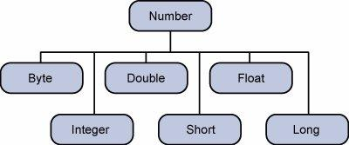
Numbers
There are lots of types of Numbers
  Integer, Long, and Double are most common

Slide 28
Java Boxing
Java will convert primitives to Objects for you – be careful with this!
public class Test {
public static void main(String args[]) {
Integer x = 5; // boxes int to an Integer object
x = x + 10; // unboxes the Integer to a int
System.out.println(x);
}
}

Slide 29
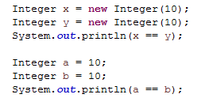

Java Boxing
In the first case we create two Integers, each with 10 in them
In the second case there is one global constant Integer(10) that both are pointing to

Slide 30
Strings
Internally it's an array of characters
public class StringDemo {
public static void main(String args[]) {
String palindrome = "Dot saw I was Tod";
int len = palindrome.length();
System.out.println( "String Length is : " + len );
}
}

Slide 31
Strings
They can be added (create a new String)
  “Hello “ + “World!” = “Hello World”
Or formatted (C style)
  String worldVar = “World!”;
  String.format(“Hello %s”, worldVar);

Slide 32
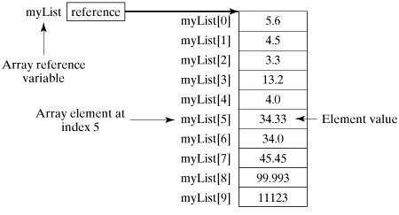
Arrays
A group of items
double[] myList; // preferred way.
or
double myList[]; // works but not preferred way.

Slide 33
Arrays
public static void main(String[] args) {
double[] myList = {1.9, 2.9, 3.4, 3.5};
// Print all the array elements
for (int i = 0; i < myList.length; i++) {
System.out.println(myList[i] + " ");
}
// Summing all elements
double total = 0;
for (int i = 0; i < myList.length; i++) {
total += myList[i];
}
System.out.println("Total is " + total);
// Finding the largest element
double max = myList[0];
for (int i = 1; i < myList.length; i++) {
if (myList[i] > max) max = myList[i];
}
System.out.println("Max is " + max);
}

Slide 34
Array vs. ArrayList
An ArrayList is a Java data type that has lots of methods already implemented
double[] myList = {1.9, 2.9, 3.4, 3.5};
// Add an element
double[] temp = new double[myList.length+1]
for (int i = 0; i < myList.length; i++) {
temp[i] = myList[i];
}
temp[myList.length] = “99.9”;
MyList = temp;
ArrayList<Double> myList =
new ArrayList<Double();
myList.add(3.5);
myList.add(99.9);

